Slide 1
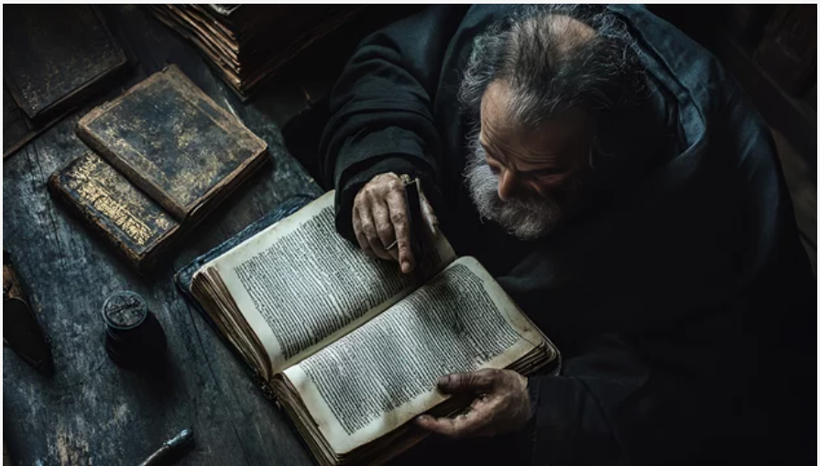
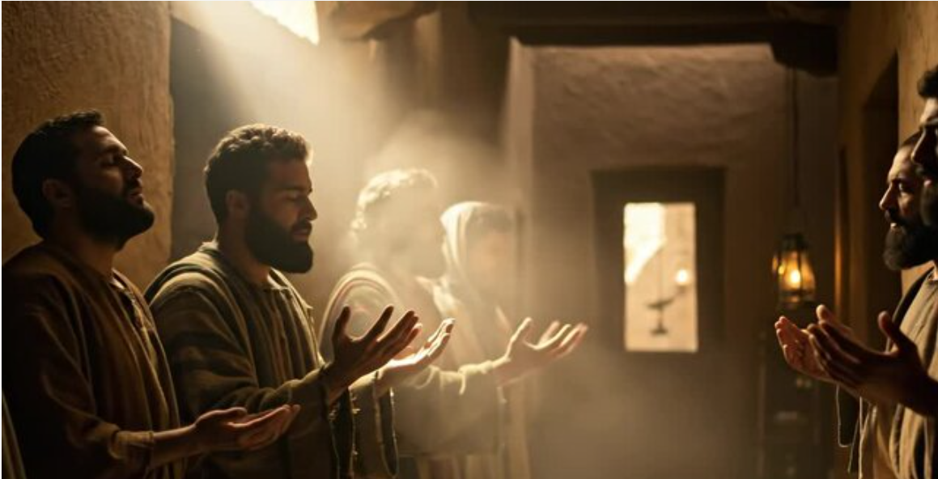
Devoted …to
Fellowship!!!
Notes:
Understanding Zacchaeus requires insight into his identity, the social role of tax collectors, and the importance of Jericho in biblical history.

Slide 2
1 John 1: 3 - 4!
John’s Message…
³ We proclaim to you what we have seen and heard, so that you also may have fellowship with us. And our fellowship is with the Father and with his Son, Jesus Christ. ⁴ We write this to make our joy complete.
Notes:
Understanding Zacchaeus requires insight into his identity, the social role of tax collectors, and the importance of Jericho in biblical history.

Slide 3

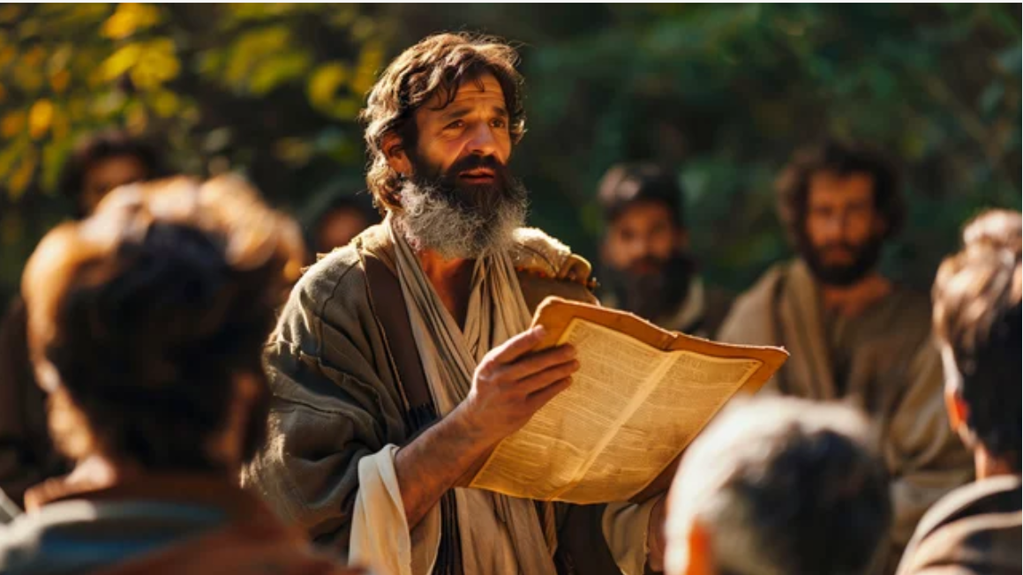
Devoted …to
Fellowship!!!
Notes:
Understanding Zacchaeus requires insight into his identity, the social role of tax collectors, and the importance of Jericho in biblical history.

Slide 4
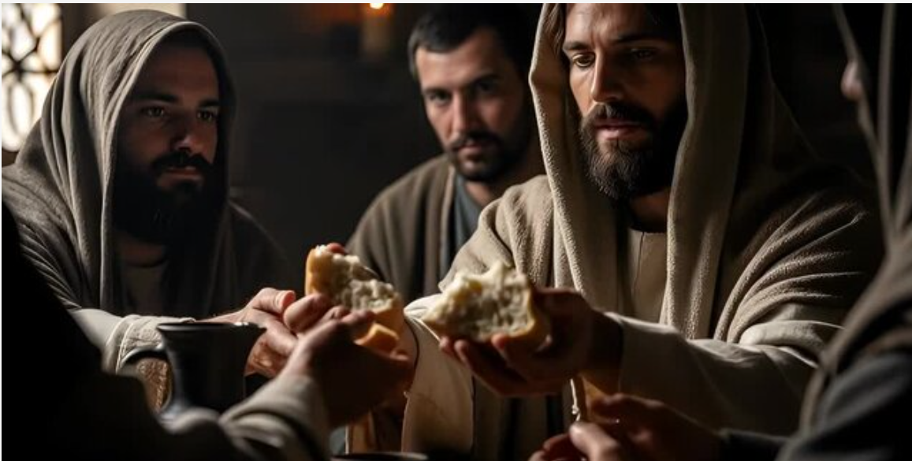
⁴² They devoted themselves to the apostles’ teaching and to fellowship, to the breaking of bread and to prayer.
Acts 2
Notes:
Understanding Zacchaeus requires insight into his identity, the social role of tax collectors, and the importance of Jericho in biblical history.

Slide 5
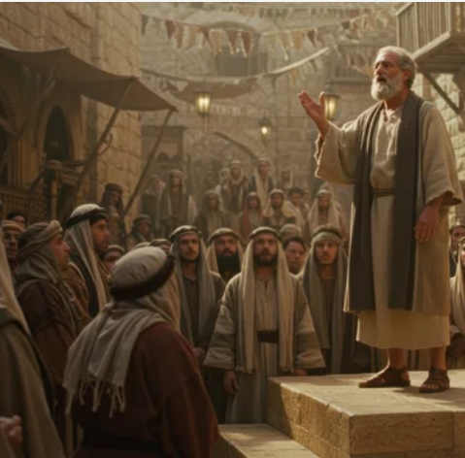
Devoted to Fellowship!
The Community | ECCLESIA
The Connections | PURPOSE
The Commitments | PARTICIPATION
Notes:
Understanding Zacchaeus requires insight into his identity, the social role of tax collectors, and the importance of Jericho in biblical history.

Slide 6


COMMUNITY. the People!
Built on Christ!
Notes:
Understanding Zacchaeus requires insight into his identity, the social role of tax collectors, and the importance of Jericho in biblical history.

Slide 7
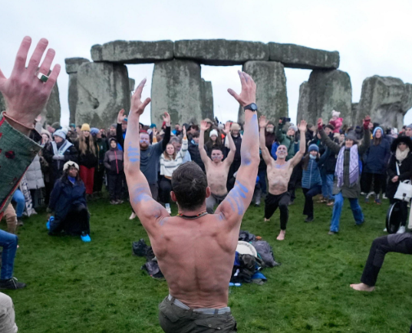


Question
~ Do communities without this DNA (Ecclesia) look any different?
Notes:
Understanding Zacchaeus requires insight into his identity, the social role of tax collectors, and the importance of Jericho in biblical history.

Slide 8

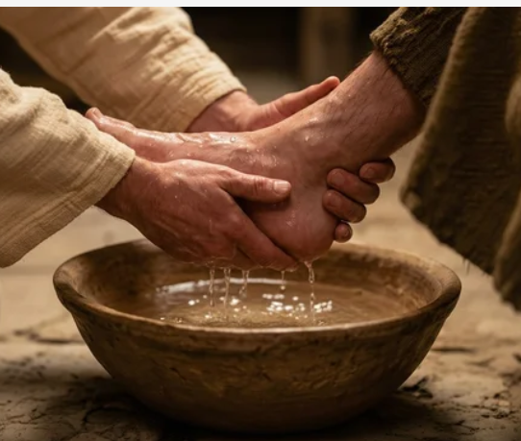
Is Community built on Christ as the Foundation!
Notes:
Luke 2:35. Matthew 2:16. John 3:19. 1 Kings 3: 16 - 28

Slide 9
Matthew 16!
Peter’s Declaration…
¹⁵ “But what about you?”
(Jesus) asked. “Who do you say I am?”
¹⁶ Simon Peter answered,
“You are the Messiah, the Son of the living God.”
¹⁷ Jesus replied, “Blessed are you, Simon son of Jonah, for this was not revealed to you by flesh and blood, but by my Father in heaven. ¹⁸ And I tell you that you are Peter, and on this rock I will build my church, and the gates of Hades will not overcome it.
Notes:
Understanding Zacchaeus requires insight into his identity, the social role of tax collectors, and the importance of Jericho in biblical history.

Slide 10


Communities defined by many factors!
Notes:
Luke 2:35. Matthew 2:16. John 3:19. 1 Kings 3: 16 - 28

Slide 11
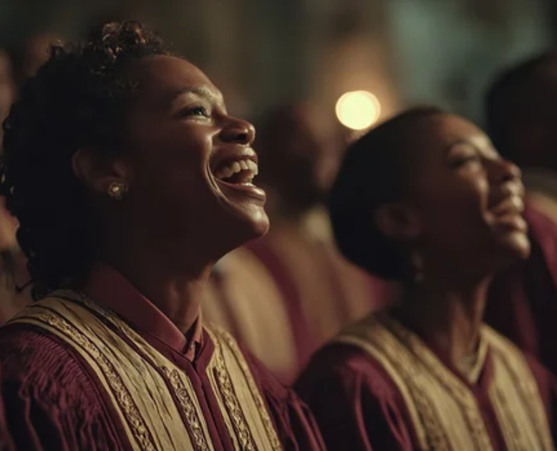


Question
~ How can we bring Christ and the Ecclesia into every community we encounter?
Notes:
Understanding Zacchaeus requires insight into his identity, the social role of tax collectors, and the importance of Jericho in biblical history.

Slide 12
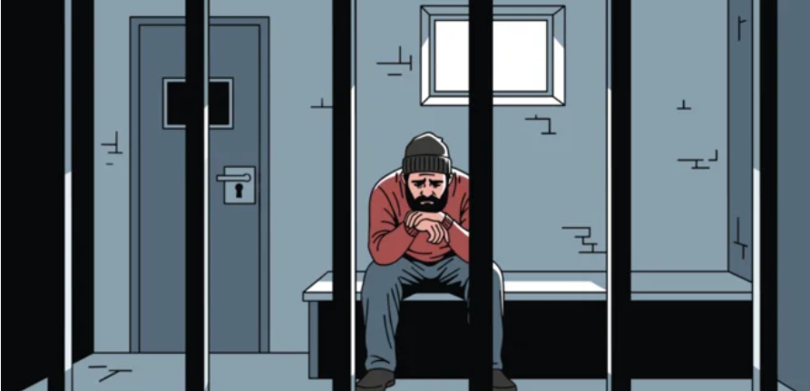
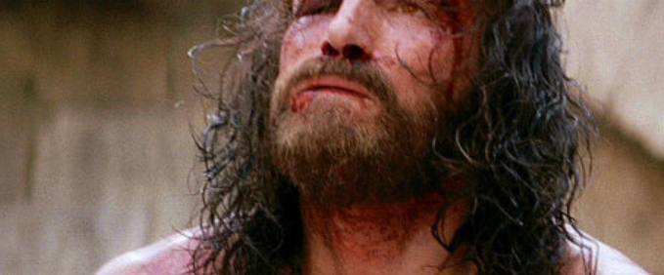
CONNECTED. the Purpose!
United in Christ!
Notes:
Understanding Zacchaeus requires insight into his identity, the social role of tax collectors, and the importance of Jericho in biblical history.

Slide 13


Question
~ what are some of the pitfalls in our gatherings that make unity a challenge?
Notes:
Understanding Zacchaeus requires insight into his identity, the social role of tax collectors, and the importance of Jericho in biblical history.

Slide 14




Are we
Connected but
Not United in Purpose!
Notes:
Luke 2:35. Matthew 2:16. John 3:19. 1 Kings 3: 16 - 28

Slide 15
John 17!
Jesus’ Prayer…
²⁰ “My prayer is not for them alone. I pray also for those who will believe in me through their message, ²¹ that all of them may be one, Father, just as you are in me and I am in you. May they also be in us so that the world may believe that you have sent me.
²² I have given them the glory that you gave me, that they may be one as we are one— ²³ I in them and you in me—so that they may be brought to complete unity. Then the world will know that you sent me and have loved them even as you have loved me.
Notes:
Understanding Zacchaeus requires insight into his identity, the social role of tax collectors, and the importance of Jericho in biblical history.

Slide 16
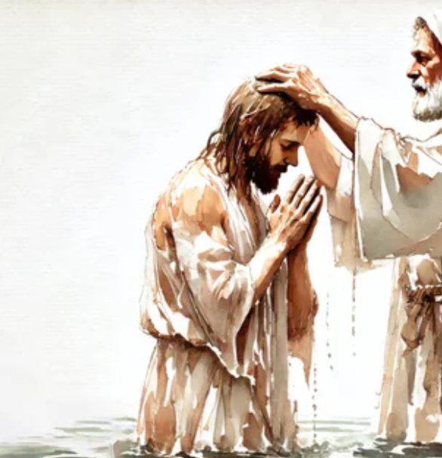
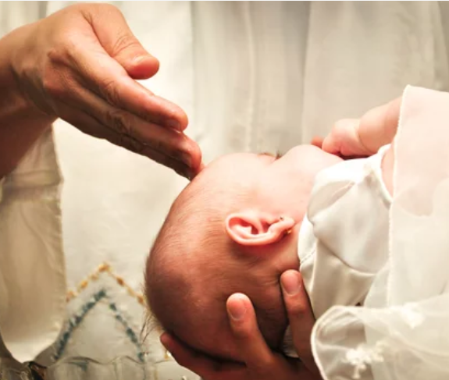
Community united in Spirit to form One Body!
Notes:
Luke 2:35. Matthew 2:16. John 3:19. 1 Kings 3: 16 - 28

Slide 17

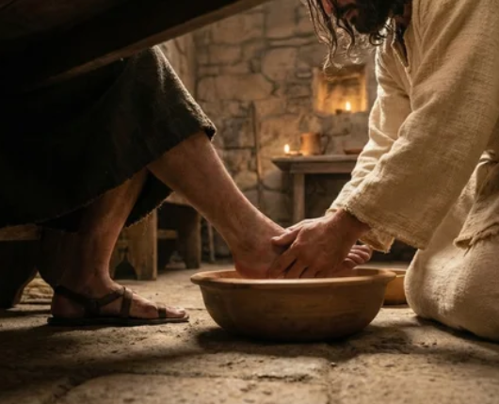
Question
~ How can we reconcile our differences so that we can keep the unity of spirit in all matters?
Notes:
Understanding Zacchaeus requires insight into his identity, the social role of tax collectors, and the importance of Jericho in biblical history.

Slide 18


COMMITMENT. the Participation!
Active Participation!
Notes:
Understanding Zacchaeus requires insight into his identity, the social role of tax collectors, and the importance of Jericho in biblical history.

Slide 19



Question
~ How are we to live out this common spiritual life, this togetherness?”
Notes:
Understanding Zacchaeus requires insight into his identity, the social role of tax collectors, and the importance of Jericho in biblical history.

Slide 20
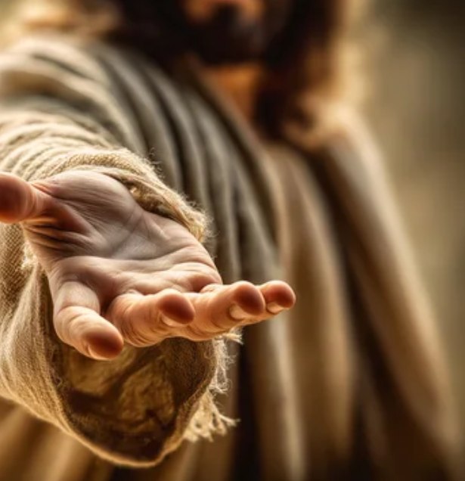

A Community devoted to
Active Participation.
Notes:
Luke 2:35. Matthew 2:16. John 3:19. 1 Kings 3: 16 - 28

Slide 21
Acts 2!
The Fellowship of Believers…
⁴² They devoted themselves to the apostles’ teaching and to fellowship, to the breaking of bread and to prayer. ⁴³ Everyone was filled with awe at the many wonders and signs performed by the apostles. ⁴⁴ All the believers were together and had everything in common.
⁴⁵ They… sold property and possessions to give to anyone who had need. ⁴⁶ Every day they continued to meet together in the temple courts. They… broke bread in their homes and ate together with glad and sincere hearts,
Notes:
Understanding Zacchaeus requires insight into his identity, the social role of tax collectors, and the importance of Jericho in biblical history.

Slide 22
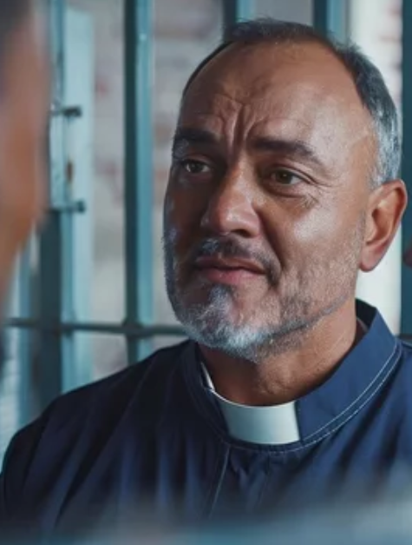
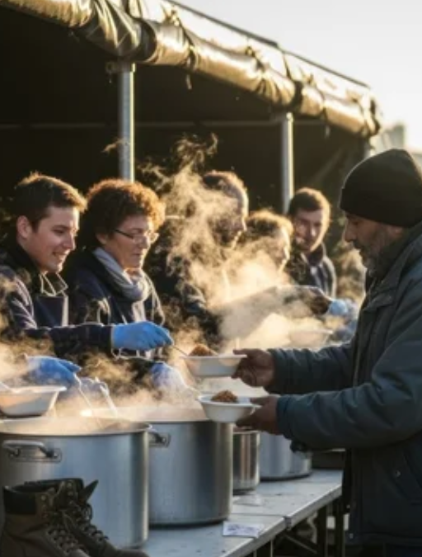

Are we
Committed but
Not Active Participants
Notes:
Luke 2:35. Matthew 2:16. John 3:19. 1 Kings 3: 16 - 28

Slide 23
Devoted to Fellowship!
The Community | ECCLESIA
The Connections | PURPOSE
The Commitments | PARTICIPATION
Notes:
Understanding Zacchaeus requires insight into his identity, the social role of tax collectors, and the importance of Jericho in biblical history.

Slide 24
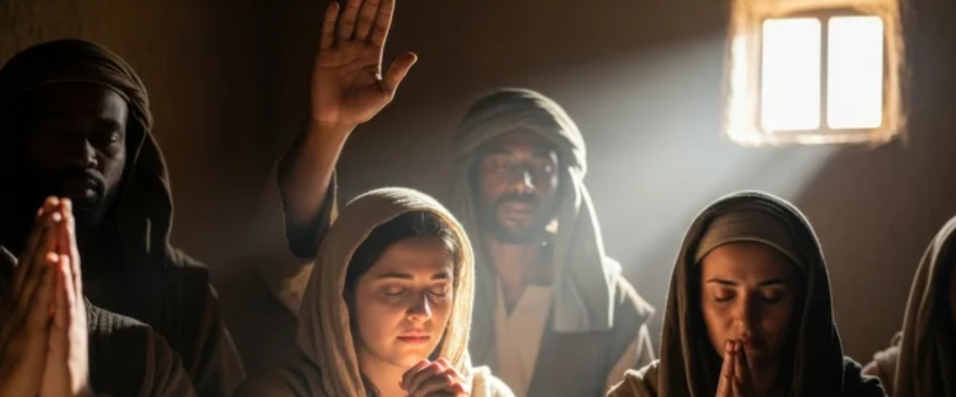
Devoted …to
Fellowship!!!
Notes:
Understanding Zacchaeus requires insight into his identity, the social role of tax collectors, and the importance of Jericho in biblical history.

Slide 25
Devotion to Fellowship!
Community
Commitment
Connected
Ecclesia:
Not just any gathering, but a gathering with Christ as the foundation!
Unity:
Not just connected but also united in Spirit and in Truth.
Shared Life:
A commitment to Active Participation
Notes:
Understanding Zacchaeus requires insight into his identity, the social role of tax collectors, and the importance of Jericho in biblical history.

